Slide 1

DEE 4544 DIGITAL ELECTRONICS Chapter 1: Binary System and Logic Circuits
By : Dr. Noraisyah Tajudin
Email: noraisyahtajudin@lincoln.edu.my
Faculty of Engineering
Lincoln University College (LUC)
LECTURE 1
DATE : MARCH 2024

Slide 2
Why binary number?
Binary is a language written with a combination of ones (1) and zeros (0) that computers use to carry out commands, inputs, or functions. Whatever you write onto a computer, a machine inside processes the input and converts it into binary.
Each unit of memory media (hard disk, tape, CD …) has two states to represent 0 and 1
Such physical (electronic) device is easier to make, less prone to error
E.g., a voltage value between 0-3mv is 0, a value between 3-6 is 1 …

Slide 3
The Advantage of Binary Number Systems
1. Binary devices are Simple and easy to build
An on/off switch is simple and easy to build. An on/off switch moves two pieces of metal together or moves them apart.
The same is true for the tiny devices inside of a silicon chip. On/off switches are relatively easy to fabricate.
2. Binary signals are Unambiguous (which gives them noise immunity)
It is easy to look at a digital signal that is only supposed to be on or off and decide which it is supposed to be.

Slide 4
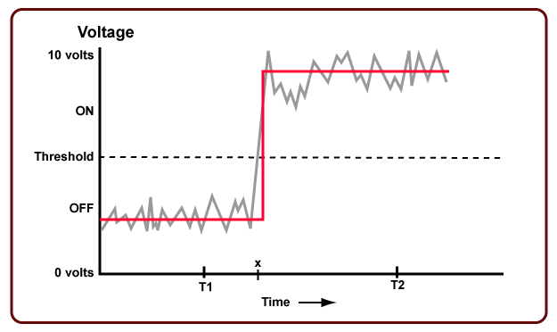
3. Flawless copies can be made of binary data
4. Anything that can be represented with some sort of pattern can be represented with a binary pattern

Slide 5
Data Representation in Computer
In modern computers, all information is represented using binary values.
Each storage location (cell): has two states
low-voltage signal => 0
High-voltage signal => 1
i.e., it can store a binary digit, i.e., bit
Eight bits grouped together to form a byte
Several bytes grouped together to form a word
Word length of a computer, e.g., 32 bits computer, 64 bits computer

Slide 6
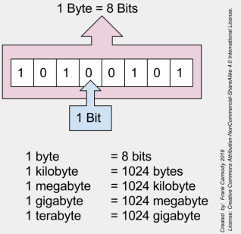
Bytes and Bits
In binary, we have bytes and bits which are major components in writing binary.
Bit: a single 0 or 1 in a binary number
Byte: eight bits put together

Slide 7
What is a gate?
The building blocks used to create digital circuits are logic gates
Combination of transistors that performs binary logic
There are three elementary logic gates and a range of other simple gates
Each gate has its own logic symbol which allows complex functions to be represented by a logic diagram
The function of each gate can be represented by a truth table or using Boolean notation

Slide 8
LOGIC GATES
Types of gates
NOT
AND
OR
NAND
NOR
EX-OR
EX-NOR
BUFFER GATE

Slide 9
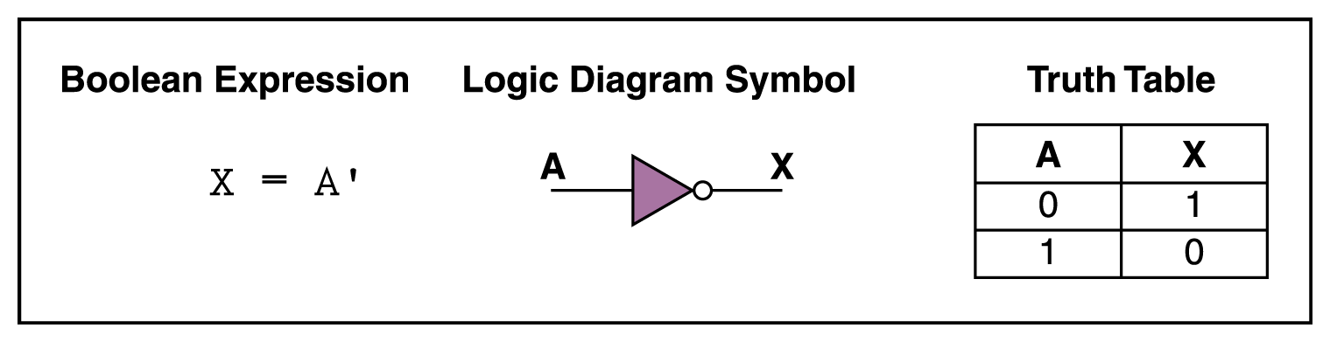
NOT Gate
A NOT gate accepts one input value and produces one output value
By definition, if the input value for a NOT gate is 0, the output value is 1, and if the input value is 1, the output is 0
A NOT gate is sometimes referred to as an inverter because it inverts the input value

Slide 10
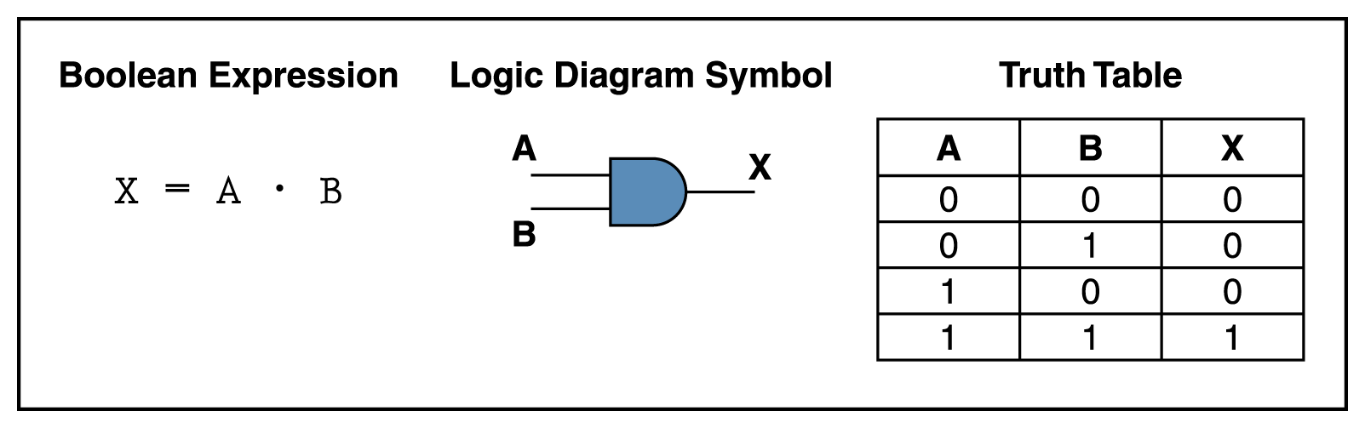
AND Gate
An AND gate accepts two input signals
If the two input values for an AND gate are both 1, the output is 1; otherwise, the output is 0

Slide 11
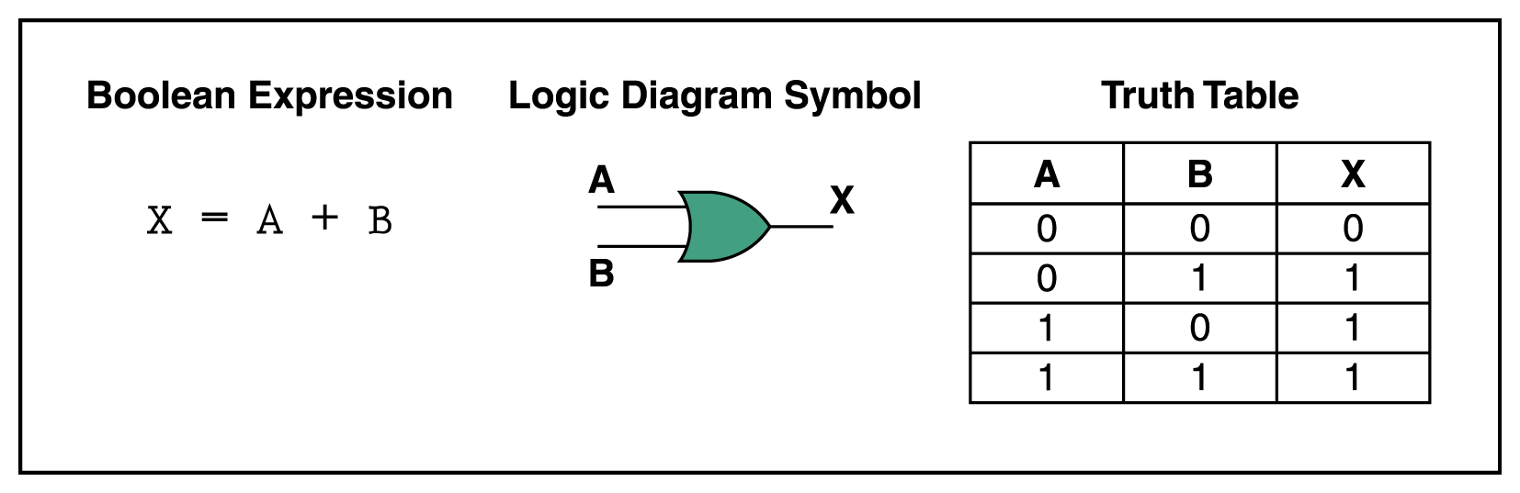
OR Gate
If the two input values are both 0, the output value is 0; otherwise, the output is 1

Slide 12
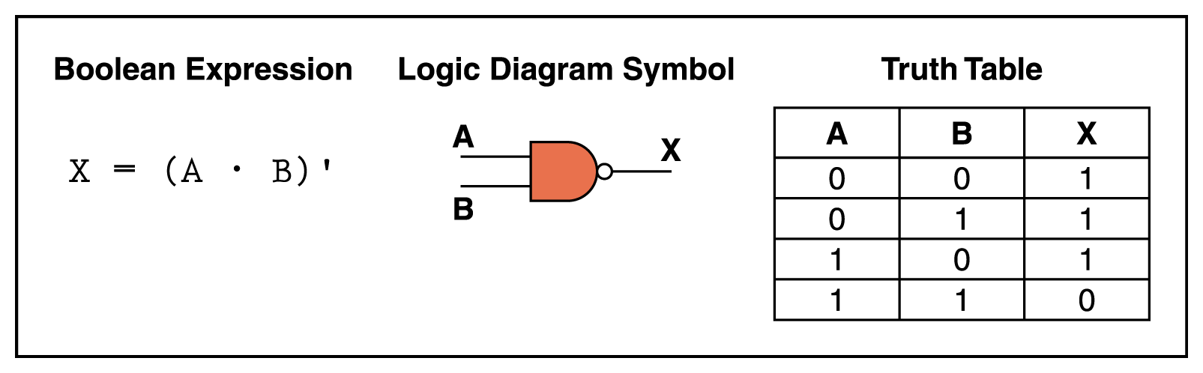
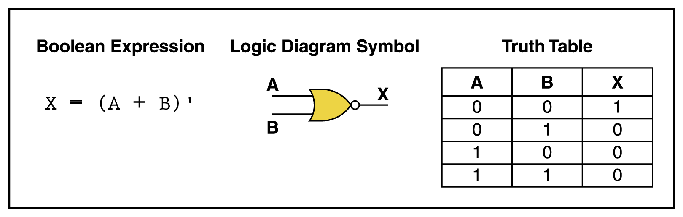
NAND and NOR Gates
The NAND and NOR gates are essentially the opposite of the AND and OR gates, respectively.
They are also called universal gates.

Slide 13
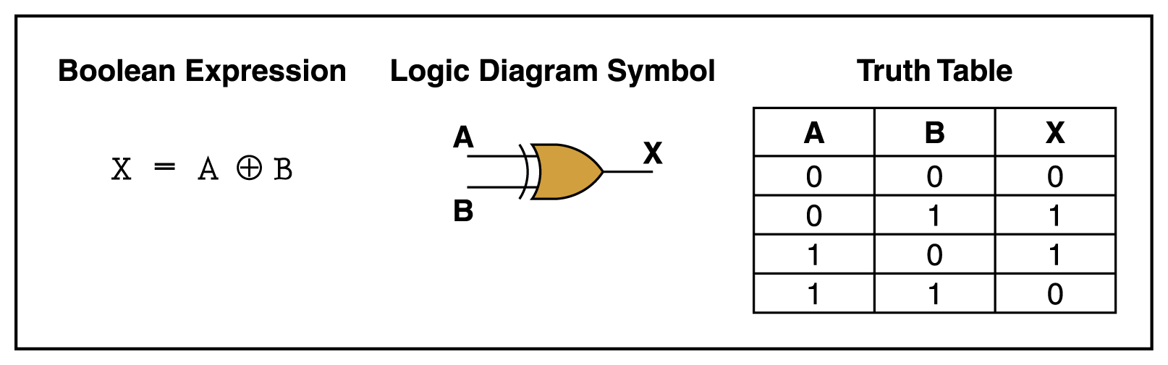
XOR Gate
XOR, or exclusive OR, gate
An XOR gate produces 0 if its two inputs are the same, and a 1 otherwise

Slide 14
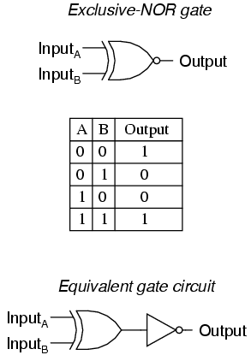
XNOR Gate
The exclusive-nor gate or xnor is logically equivalent to
an xor gate followed by an inverter

Slide 15
Logic Family Terminology
A digital logic family is a group of compatible devices with the same logic levels and supply voltages.
According to components used in the same logic family, digital logic families are classified as:
Resistor-Transistor logic
Diode- transistor logic
Transistor-transistor logic
MOS families----NMOS logic, PMOS logic, CMOS logic
Emitter-Coupled Logic

Slide 16
Characteristics of Digital Logic Families
Propagation delay
Power dissipation
Current and voltage parameter
Noise margin and logic voltages levels
Fan-in and Fan-out
Current Sinking
Current Sourcing
Speed Power Product

Slide 17
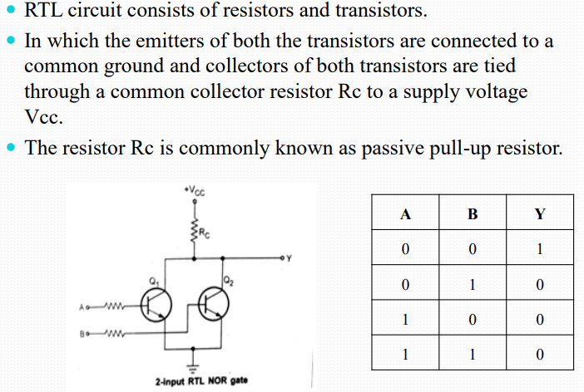
Resistor – Transistor Logic (RTL)

Slide 18
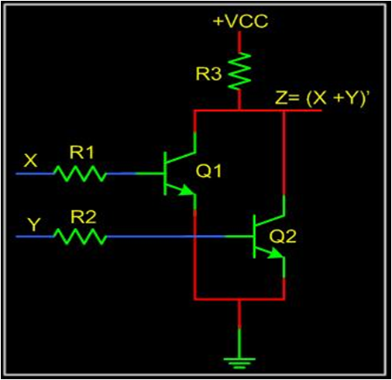
Resistor Transistor logic
It has a fan-out of 5.
Propagation delay is 25ns.
Power dissipation is 12mw.
Noise margin for low signal input is 0.4v.
Poor noise immunity.
lLow speed.

Slide 19
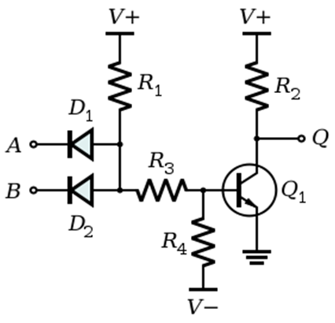
Diode Transistor Logic
It has fan-out of 8.
It has high noise immunity.
Power dissipation is 12mw.
Propagation constant is average 30ns.
Noise margin is about 0.7v.

Slide 20
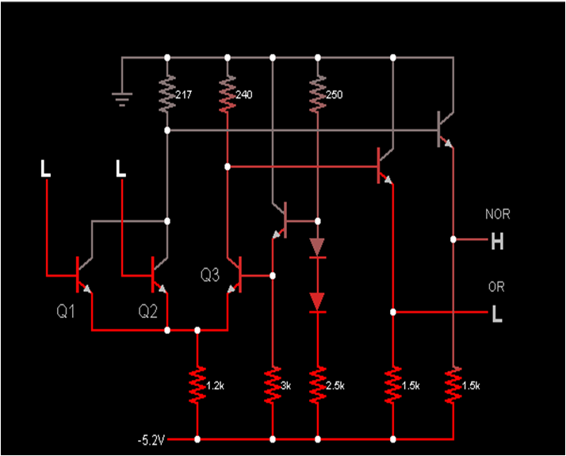
Emitter Coupled Logic
Propagation delay is very low (<1ns).
ECL is fastest logic family.
ECL circuit usually operate with -ive supplies (+ive terminal is connected to ground).

Slide 21
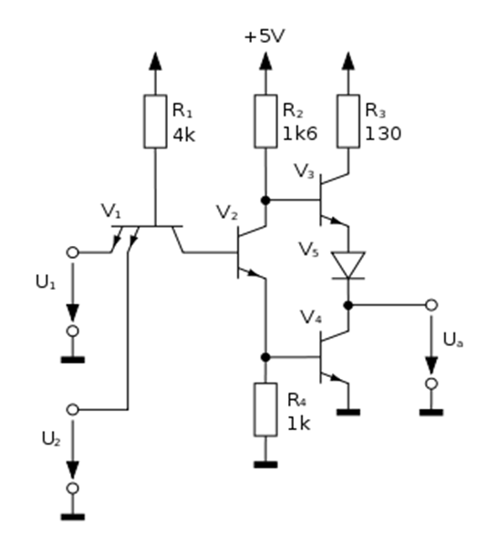
Transistor Transistor Logic
TTl has greater speed than DTL.
Less noise immunity.
Power dissipation is 10nw.
It has fan-in of 6 and fan-out of 10.
Propagation time delay is 5-15nsec.

Slide 22
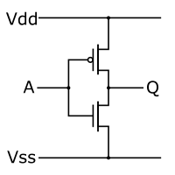
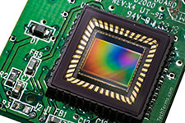
CMOS
Dissipates low power, power dissipation is typically 10 nW per gate.
The propagation delays are usually around 25 nS to 50 nS.
Noise immunity approaches 50% or 45% of the full logic swing.

Slide 23
Thank You.

